Slide 1
Regex validation
screen level field validations using regular expression

Slide 2
Technology & Platform
Platform: Java, Spring Boot, thymeleaf, JUnit

Slide 3
Points Covered
Regex(Regular Expression) is used to validate number, text, PAN, Passport currency, age, restricting special characters, restricting character range, etc.

Slide 4
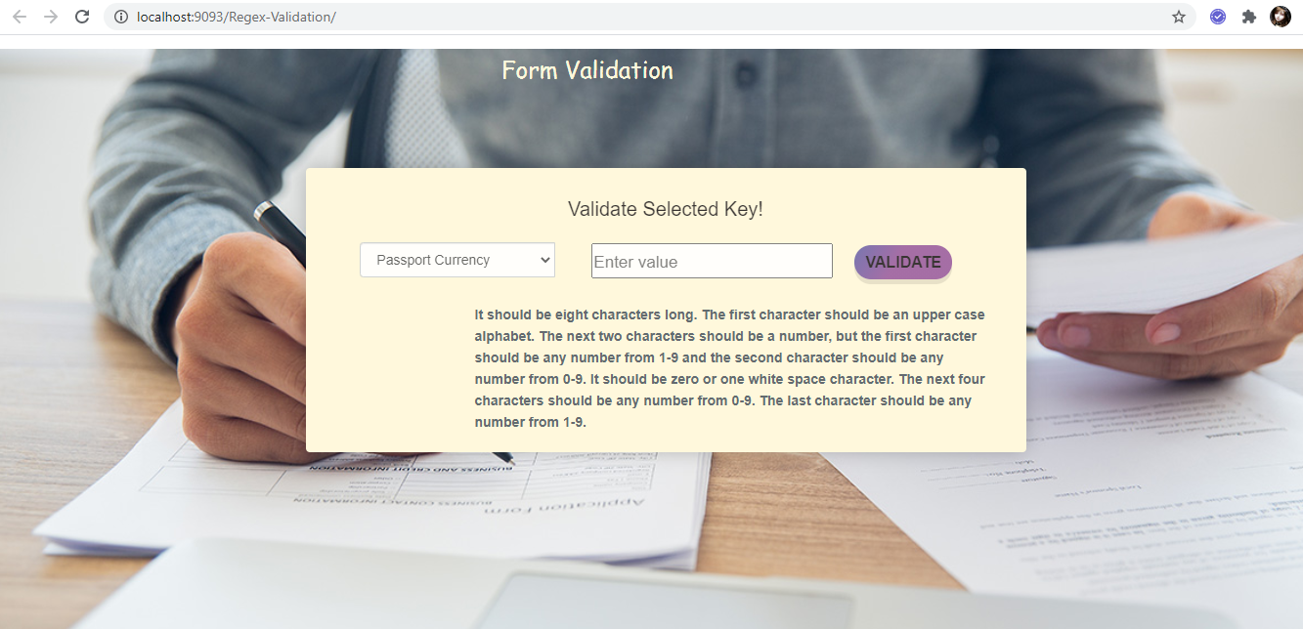
Validation screen

Slide 5
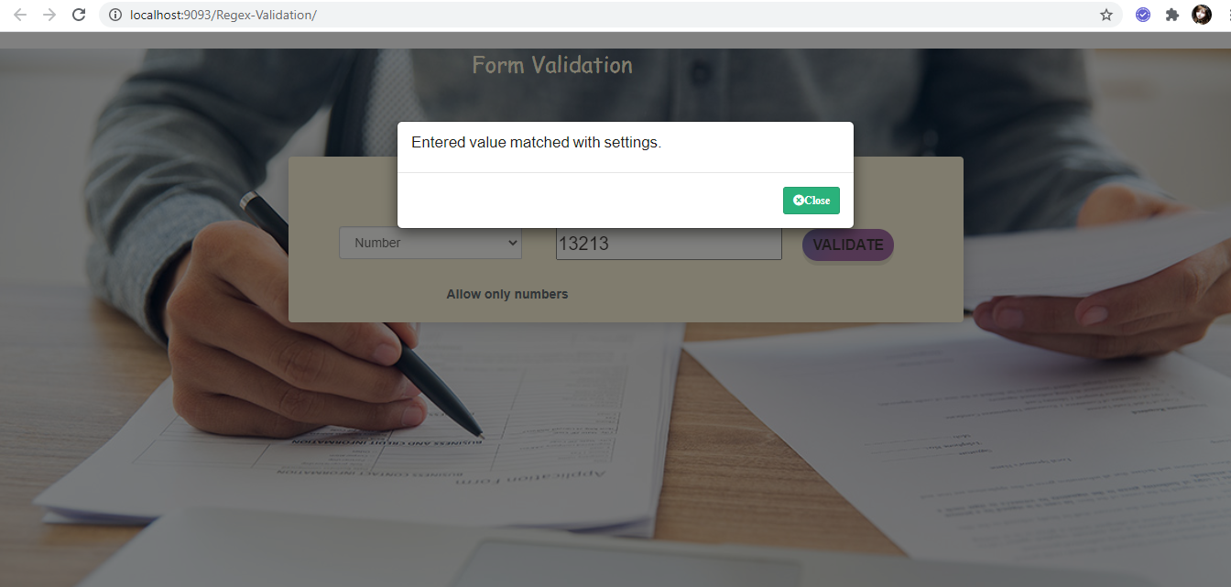
Validation message

